Slide 1
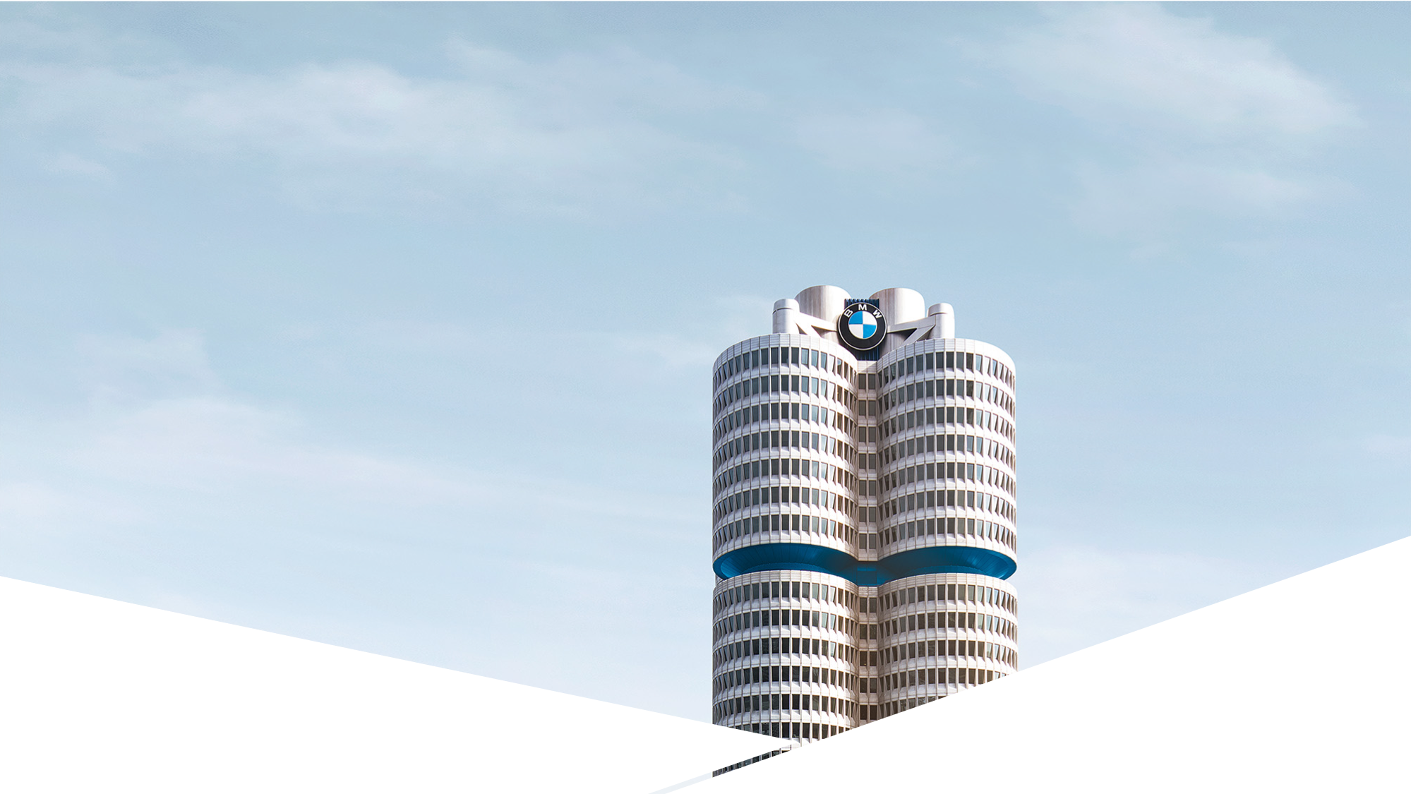

J.d. power ratings.
Customer sentiment analysis.
Eric Paulz
FG-AM-7 | June 2018
Notes:
Thank you for joining
I’ll be talking about what I’ve been working on since I arrived here earlier this summer, which is an analysis of option take rates.
Part of the large used car pricing model that Sandeep and Matthew have been working on.

Slide 2
J.d. power 2018 ratings. Overview.
Objective.
Methodology.
Results.

Slide 3



j.d. power 2018 ratings. 1. Objective.
Analyze and extract emotions from customer feedback.
Calculate overall sentiment score for each vehicle represented in the survey.
Identify trends in the data from 2015 through 2018.

Slide 4
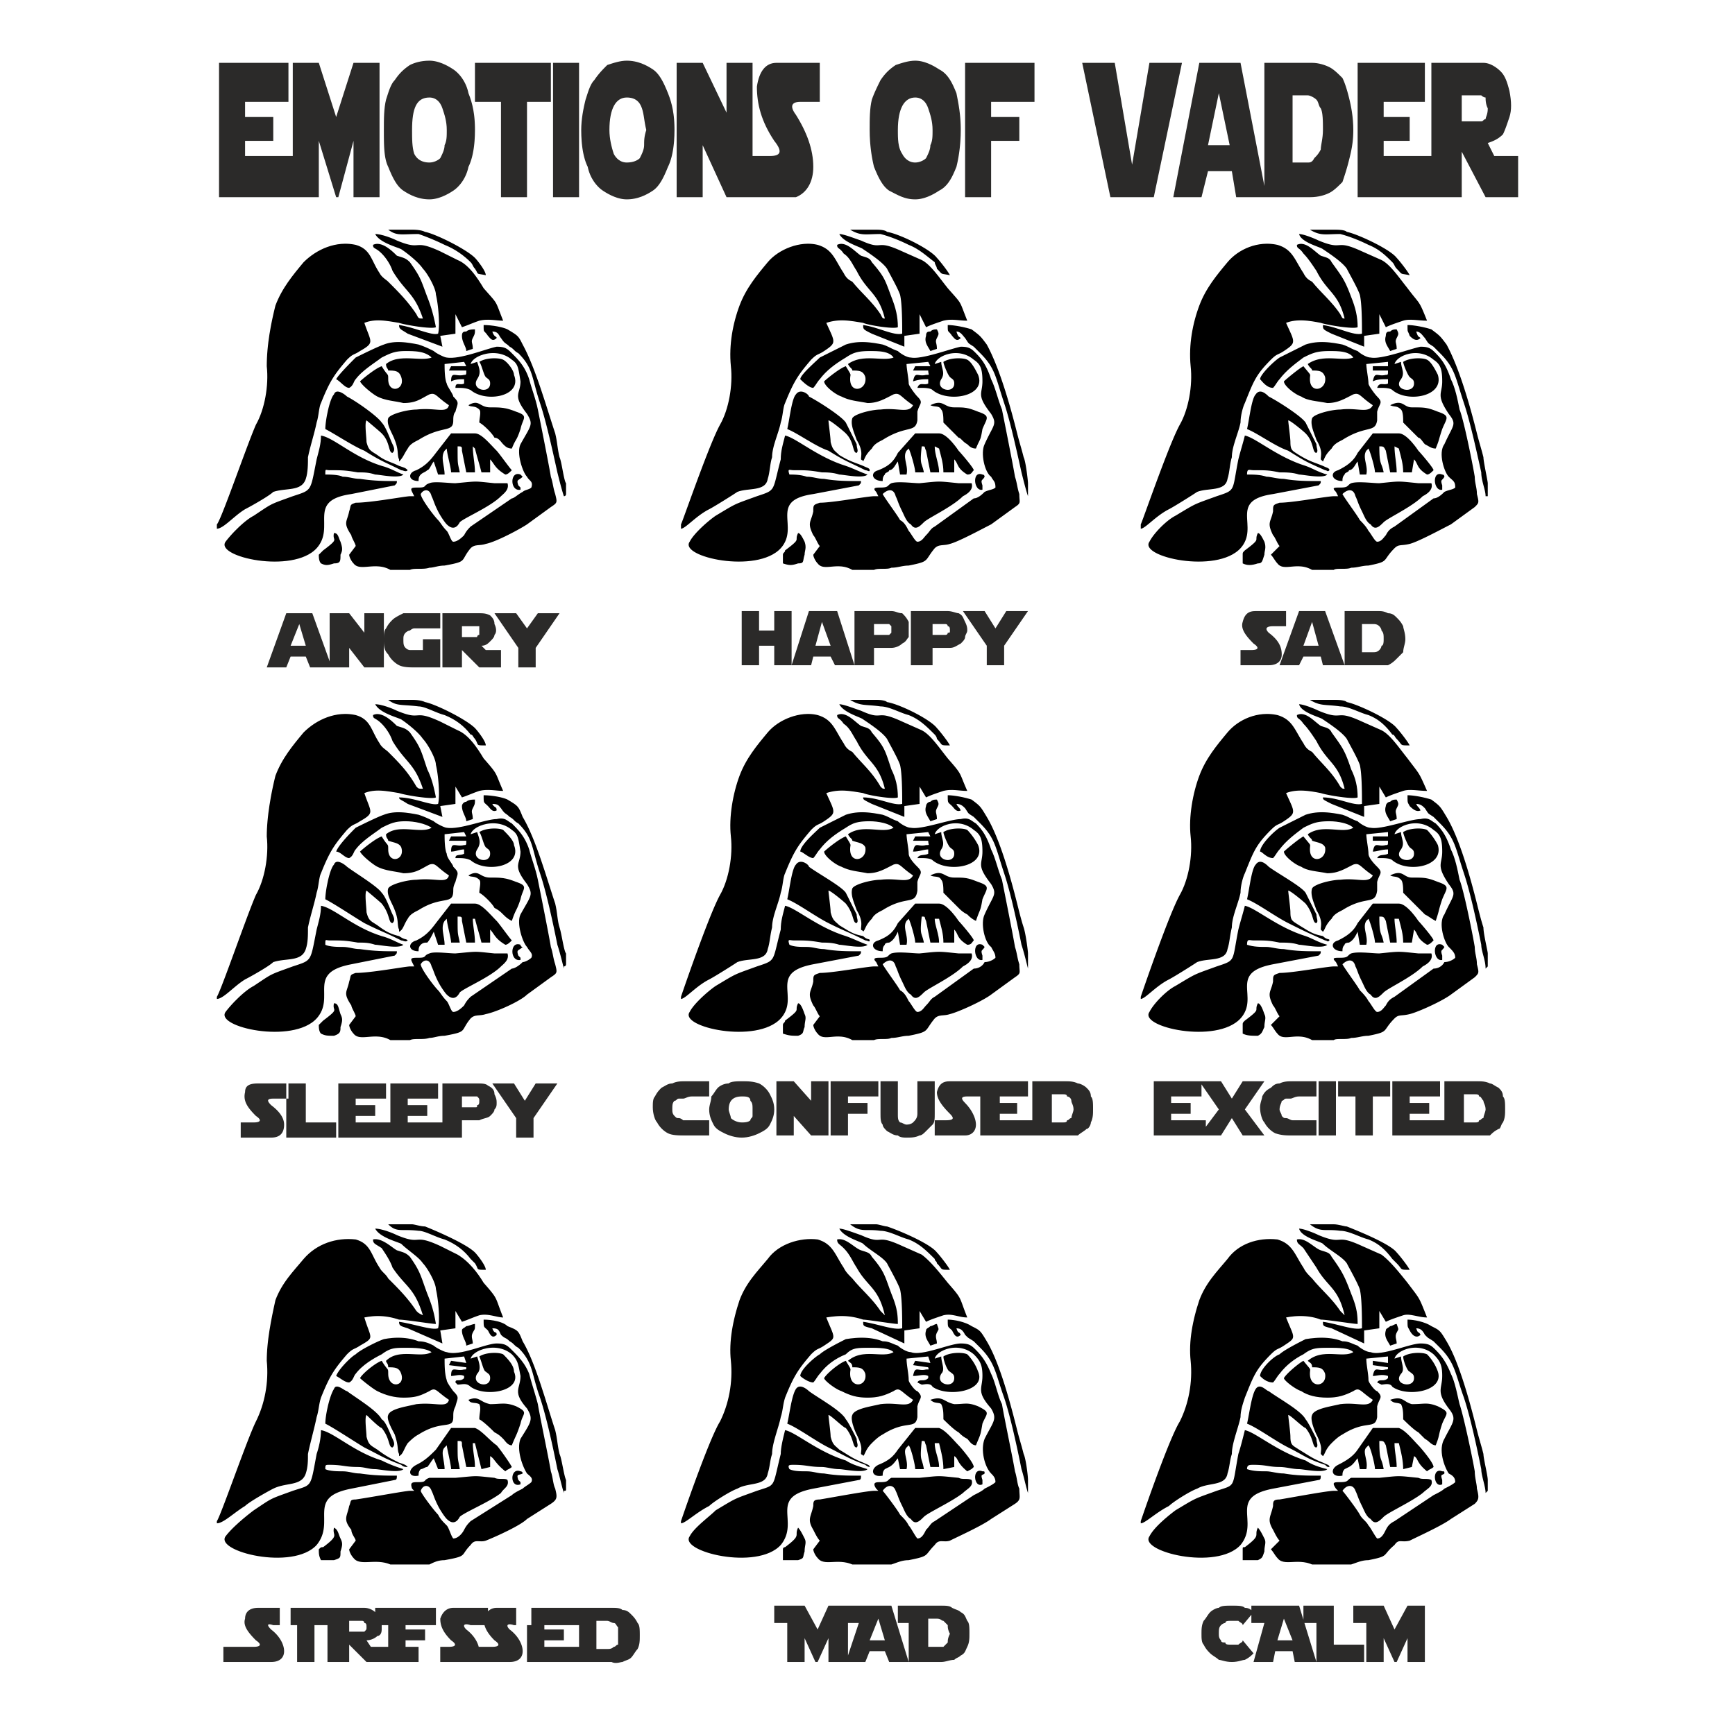
j.d. power 2018 ratings. 2. Methodology.
Sentiment analysis using VADER.
VADER = Valence Aware Dictionary for sEntiment Reasoning.
Measures polarity (positive/negative) AND intensity of emotion.
Created by C.J. Hutto and Eric Gilbert of Georgia Tech.
Part of Python’s Natural Language Toolkit (NLTK).
Initially used for social media (Tweets), but has become popular many other domains such as product reviews.

Slide 5
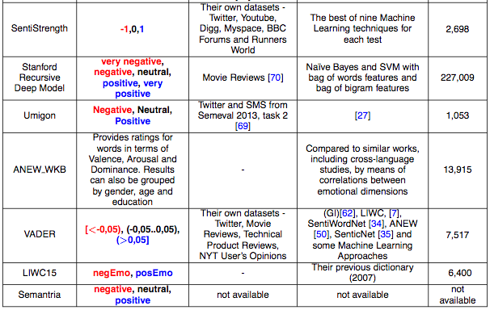
j.d. power 2018 ratings. 2. Methodology.
Figure 01: Sentiment Analysis Tool Comparison from SentiBench*
*https://pdfs.semanticscholar.org/389c/8b5ad61f92de080375efb267b4f1a83b2bd5.pdf

Slide 6
j.d. power 2018 ratings. 2. Methodology.
Examples:
Make | Series | Category | Mode | Verbatim | Score
BMW | X3 | Features/Controls/Displays (FCD) | D | I ABSOLUTELY HATE the automatic shut off on the ignition! You should have the option to turn that off to stay off, as it is I have to remember to turn it off everytime I start the vehicle. This can not be good on the engine to keep shutting off and starting | -0.8465
BMW | 4 Series | Features/Controls/Displays (FCD) | D | I have no idea how to make this system work. | -0.296
BMW | 4 Series | Interior | D | Driver side floor mat becomes detached from peggged holes periodically when entering and exiting the vehicle. | -0.128
BMW | 5 Series | Interior | M | Sliding door can come out of alignment. Can fix by myself when it happens. | 0
BMW | X3 | Features/Controls/Displays (FCD) | D | The heated steering wheel in my 2006 3-series seemed to get hotter..this one is too mildly warm | 0.2263
BMW | 2 Series | Features/Controls/Displays (FCD) | D | Just a recommendation: the central locking system was originally hard to find. It may be better located on the drivers door or by the gearshift. | 0.3612

Slide 7
j.d. power 2018 ratings. 3. results.
See Tableau (https://tableau.bmwgroup.net/ - /workbooks/295/views)

Slide 8
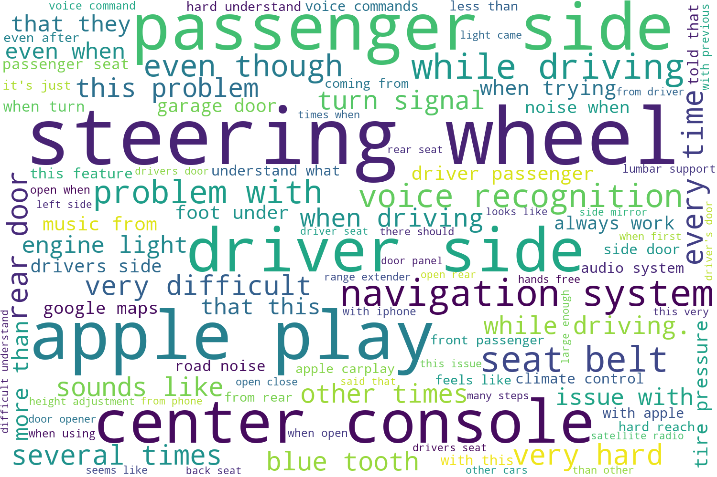
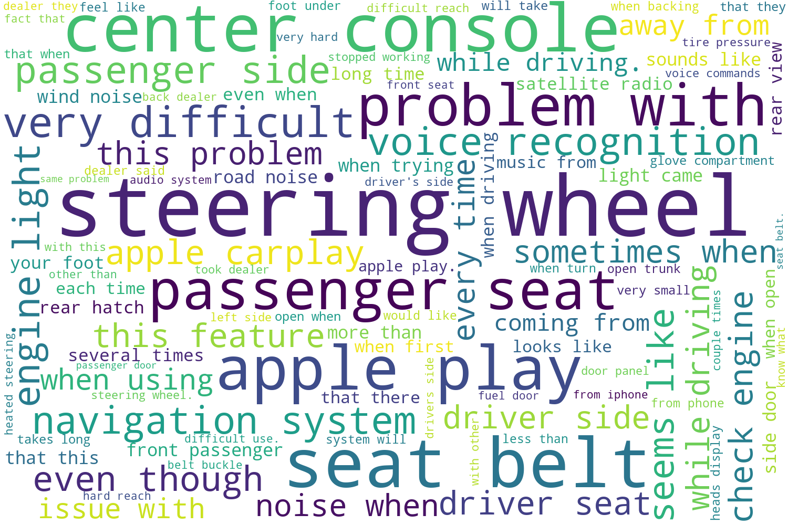
j.d. power 2018 ratings. 3. results.
2017
2018

